Slide 1
ESE
Einführung in Software Engineering
8. User Interface Design
Prof. O. Nierstrasz

Slide 2

Roadmap
ESE — User Interface Design
Interface design models
Design principles
GUI characteristics
User Guidance
Usability Testing
Examples
© Oscar Nierstrasz
ESE 8.<number>

Slide 3
Literature
ESE — User Interface Design
Sources
Software Engineering, I. Sommerville, 7th Edn., 2004.
Software Engineering — A Practitioner’s Approach, R. Pressman, Mc-Graw Hill, 5th Edn., 2001.
Recommended reading
Mary Beth Rosson, John M. Carroll, Usability Engineering, 2002
Jakob Nielsen, Usability Engineering, Morgan Kaufmann, 1999.
Alan Cooper, About Face — The Essentials of User Interface Design, Hungry Minds, 1995.
Alan Cooper, The Inmates are running the Asylum, SAMS, 1999.
Jef Raskin, The Humane Interface, Addison Wesley, 2000.
Jeff Johnson, GUI Bloopers, Morgan Kaufmann, 2000.
The Interface Hall of Shame, http://homepage.mac.com/bradster/iarchitect/shame.htm
© Oscar Nierstrasz
ESE 8.<number>
Notes:
http://homepage.mac.com/bradster/iarchitect/shame.htm
http://www.frankmahler.de/mshame/

Slide 4
Roadmap
ESE — User Interface Design
Interface design models
Design principles
GUI characteristics
User Guidance
Usability Testing
Examples
© Oscar Nierstrasz
ESE 8.<number>

Slide 5
The UI design process
ESE — User Interface Design
UI design is an iterative process involving close liaisons between users and designers.
The 3 core activities in this process are:
  User analysis. Understand what the users will do with the system;
  System prototyping. Develop a series of prototypes for experiment;
  Interface evaluation. Experiment with these prototypes with users.
© Oscar Nierstrasz
ESE 8.<number>

Slide 6
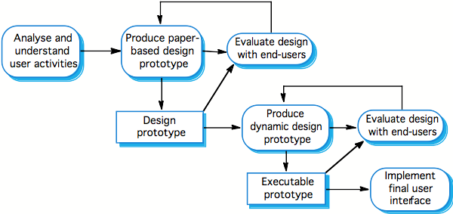
The design process
ESE — User Interface Design
© Ian Sommerville 2004
© Oscar Nierstrasz
ESE 8.<number>

Slide 7
Interface Design Models
ESE — User Interface Design
Four different models occur in HCI design:
The design model expresses the software design.
The user model describes the profile of the end users. (i.e., novices vs. experts, cultural background, etc.)
The user’s model is the end users’ perception of the system.
The system image is the external manifestation of the system (look and feel + documentation etc.)
© Oscar Nierstrasz
ESE 8.<number>

Slide 8
UI Models
ESE — User Interface Design
…
Implementation Model
Mental Model
Worse
Manifest Models
Better
Alan Cooper, About Face, 1995
© Oscar Nierstrasz
ESE 8.<number>

Slide 9
Roadmap
ESE — User Interface Design
Interface design models
Design principles
GUI characteristics
User Guidance
Usability Testing
Examples
© Oscar Nierstrasz
ESE 8.<number>

Slide 10
User Interface Design Principles
ESE — User Interface Design
Principle | Description
User familiarity | Use terms and concepts familiar to the user.
Consistency | Comparable operations should be activated in the same way. Commands and menus should have the same format, etc.
Minimal surprise | If a command operates in a known way, the user should be able to predict the operation of comparable commands.
Feedback | Provide the user with visual and auditory feedback, maintaining two-way communication.
© Oscar Nierstrasz
ESE 8.<number>

Slide 11
ESE — User Interface Design
Principle | Description
Memory load | Reduce the amount of information that must be remembered between actions. Minimize the memory load.
Efficiency | Seek efficiency in dialogue, motion and thought. Minimize keystrokes and mouse movements.
Recoverability | Allow users to recover from their errors. Include undo facilities, confirmation of destructive actions, 'soft' deletes, etc.
User guidance | Incorporate some form of context-sensitive user guidance and assistance.
© Oscar Nierstrasz
ESE 8.<number>

Slide 12

ESE — User Interface Design
© Oscar Nierstrasz
ESE 8.<number>

Slide 13
Roadmap
ESE — User Interface Design
Interface design models
Design principles
GUI characteristics
User Guidance
Usability Testing
Examples
© Oscar Nierstrasz
ESE 8.<number>

Slide 14
GUI Characteristics
ESE — User Interface Design
Characteristic | Description
Windows | Multiple windows allow different information to be displayed simultaneously on the user’s screen.
Icons | Usually icons represent files (including folders and applications), but they may also stand for processes (e.g., printer drivers).
Menus | Menus bundle and organize commands (eliminating the need for a command language).
Pointing | A pointing device such as a mouse is used for command choices from a menu or indicating items of interest in a window.
Graphics | Graphical elements can be commands on the same display.
© Oscar Nierstrasz
ESE 8.<number>

Slide 15
GUIs
ESE — User Interface Design
Advantages
They are easy to learn and use.
  Users without experience can learn to use the system quickly.
The user may switch attention between tasks and applications.
Fast, full-screen interaction is possible with immediate access to the entire screen
Problems
A GUI is not automatically a good interface
  Many software systems are never used due to poor UI design
  A poorly designed UI can cause a user to make catastrophic errors
© Oscar Nierstrasz
ESE 8.<number>

Slide 16
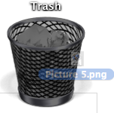
Direct Manipulation
ESE — User Interface Design
Advantages
Users feel in control and are less likely to be intimidated by the system
User learning time is relatively short
Users get immediate feedback on their actions
mistakes can be quickly detected and corrected
Problems
Finding the right user metaphor may be difficult
It can be hard to navigate efficiently in a large information space.
It can be complex to program and demanding to execute
© Oscar Nierstrasz
ESE 8.<number>

Slide 17
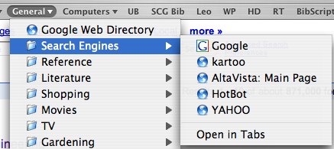
Menu Systems
ESE — User Interface Design
Advantages
Users don’t need to remember command names
Typing effort is minimal
User errors are trapped by the interface
Context-dependent help can be provided (based on the current menu selection)
Problems
Actions involving logical conjunction (and) or disjunction (or) are awkward to represent
If there are many choices, some menu structuring facility must be used
Experienced users find menus slower than command language
© Oscar Nierstrasz
ESE 8.<number>

Slide 18
Menu Structuring
ESE — User Interface Design
Scrolling menus
The menu can be scrolled to reveal additional choices
Not practical if there is a very large number of choices
Hierarchical menus
Selecting a menu item causes the menu to be replaced by a sub-menu
Walking menus
A menu selection causes another menu to be revealed
Associated control panels
When a menu item is selected, a control panel pops-up with further options
© Oscar Nierstrasz
ESE 8.<number>

Slide 19
Command Interfaces
ESE — User Interface Design
With a command language, the user types commands to give instructions to the system
May be implemented using cheap terminals
Easy to process using compiler techniques
Commands of arbitrary complexity can be created by command combination
Concise interfaces requiring minimal typing can be created
© Oscar Nierstrasz
ESE 8.<number>

Slide 20
Command Interfaces
ESE — User Interface Design
Advantages
Allow experienced users to interact quickly with the system
Commands can be scripted (!)
Problems
Users have to learn and remember a command language
Not suitable for occasional or inexperienced users
An error detection and recovery system is required
Typing ability is required (!)
© Oscar Nierstrasz
ESE 8.<number>

Slide 21
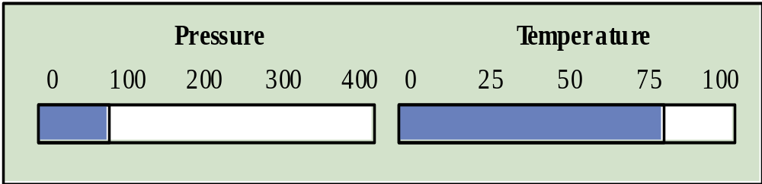
Analogue vs. Digital Presentation
ESE — User Interface Design
Digital presentation
Compact — takes up little screen space
Precise values can be communicated
Analogue presentation
Easier to get an 'at a glance' impression of a value
Possible to show relative values
Easier to see exceptional data values
© Oscar Nierstrasz
ESE 8.<number>
Notes:
Ch 15

Slide 22
Colour Use Guidelines
ESE — User Interface Design
Colour can help the user understand complex information structures.
Don’t use (only) colour to communicate meaning!
  Open to misinterpretation (colour-blindness, cultural differences ...)
  Design for monochrome then add colour
Use colour coding to support user tasks
  highlight exceptional events
  allow users to control colour coding
Use colour change to show status change
Don't use too many colours
  Avoid colour pairings which clash
Use colour coding consistently
which clash
© Oscar Nierstrasz
ESE 8.<number>

Slide 23
Roadmap
ESE — User Interface Design
Interface design models
Design principles
GUI characteristics
User Guidance
Usability Testing
Examples
© Oscar Nierstrasz
ESE 8.<number>

Slide 24
User Guidance
ESE — User Interface Design
The user guidance system is integrated with the user interface to help users when they need information about the system or when they make some kind of error.
Includes
System messages, including error messages
Documentation provided for users
On-line help
© Oscar Nierstrasz
ESE 8.<number>

Slide 25

Help system use
ESE — User Interface Design
Multiple entry points should be provided
  the user should be able to get help from different places
The help system should indicate where the user is positioned
Navigation and traversal facilities must be provided
© Oscar Nierstrasz
ESE 8.<number>

Slide 26
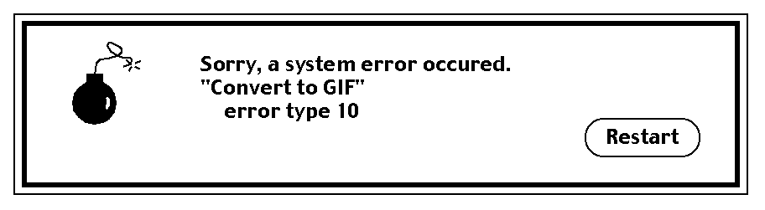
Error Message Guidelines
ESE — User Interface Design
Speak the user’s language
Give constructive advice for recovering from the error
Indicate negative consequences of the error (e.g., possibly corrupted files)
Give an audible or visual cue
Don’t make the user feel guilty!
© Oscar Nierstrasz
ESE 8.<number>
Notes:
Pressman p 471

Slide 27
Roadmap
ESE — User Interface Design
Interface design models
Design principles
GUI characteristics
User Guidance
Usability Testing
Examples
© Oscar Nierstrasz
ESE 8.<number>

Slide 28
Usability Testing
ESE — User Interface Design
Observe a group of test subjects performing a pre-defined scenario
  Which test subjects?
  How many test subjects?
  Which scenarios?
  What to observe?
Jakob Nielsen, Usability Engineering
© Oscar Nierstrasz
ESE 8.<number>

Slide 29
User interface evaluation
ESE — User Interface Design
Some evaluation of a user interface design
should be carried out to assess its usability.
Full scale evaluation is very expensive and
impractical for most systems.
Ideally, an interface should be evaluated against a usability specification. However, it is rare for such specifications to be produced.
© Oscar Nierstrasz
ESE 8.<number>

Slide 30
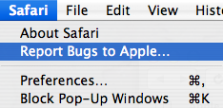
Simple evaluation techniques
ESE — User Interface Design
Questionnaires for user feedback.
Video recording of system use and subsequent tape evaluation.
Instrumentation of code to collect information about facility use and user errors.
The provision of code in the software to collect on-line user feedback.
© Oscar Nierstrasz
ESE 8.<number>

Slide 31
Hints
ESE — User Interface Design
Establish concrete goals — what do you want to achieve?
  What criteria will you use to establish “success”?
  What data will you collect?
  Choose representative test tasks.
Carry out a pilot test first.
Test users should truly represent the intended users.
Use experienced experimenters. (Get trained!)
  Make the test subjects feel comfortable.
  Don’t bias the results.
© Oscar Nierstrasz
ESE 8.<number>

Slide 32
Usability Attributes
ESE — User Interface Design
Attribute | Description
Learnability | How long does it take a new user to become productive with the system?
Speed of operation | How well does the system response match the user’s work practice?
Robustness | How tolerant is the system of user error?
Recoverability | How good is the system at recovering from user errors?
Adaptability | How closely is the system tied to a single model of work?
© Oscar Nierstrasz
ESE 8.<number>

Slide 33
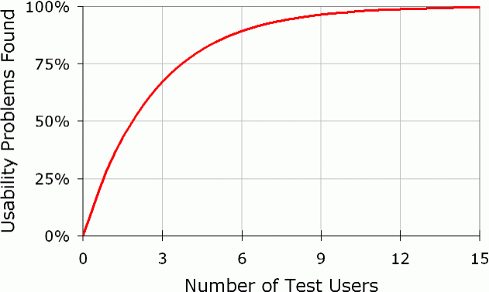
Why you only need to test with 5 users
ESE — User Interface Design
http://www.useit.com/alertbox/20000319.html
Nielsen, Jakob, and Landauer, Thomas K.: "A mathematical model of the finding of usability problems," Proceedings of ACM INTERCHI'93 Conference (Amsterdam, The Netherlands, 24-29 April 1993), pp. 206-213.
© Oscar Nierstrasz
ESE 8.<number>

Slide 34
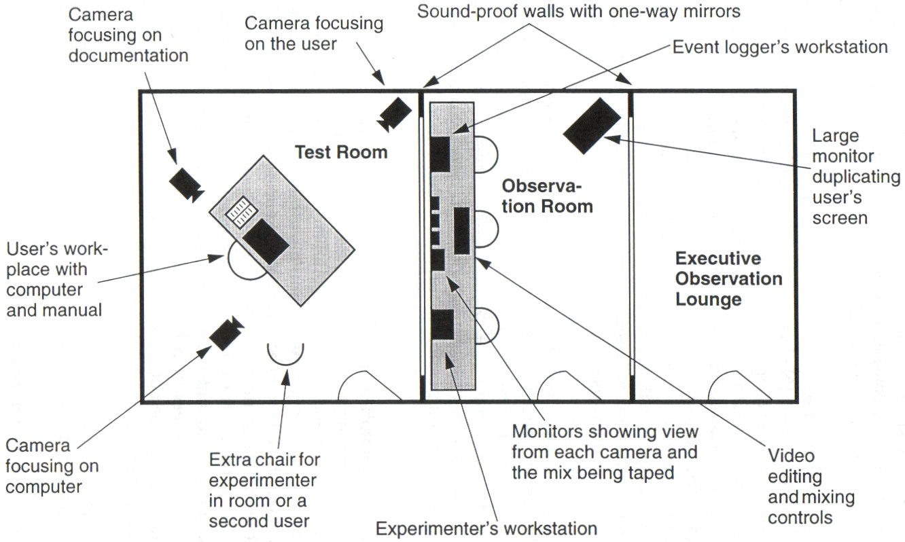
Usability laboratories (!)
ESE — User Interface Design
Jakob Nielsen, Usability Engineering
© Oscar Nierstrasz
ESE 8.<number>

Slide 35
Roadmap
ESE — User Interface Design
Interface design models
Design principles
GUI characteristics
User Guidance
Usability Testing
Examples
© Oscar Nierstrasz
ESE 8.<number>

Slide 36
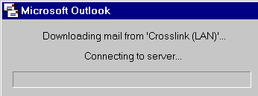
Is there progress?
ESE — User Interface Design
All examples from the Interface Hall of Shame
http://homepage.mac.com/bradster/iarchitect/shame.htm
© Oscar Nierstrasz
ESE 8.<number>
Notes:
Is there progress?
John Winters sent along a series of screen prints illustrating the useless progress meters implemented in Microsoft's Outlook . When dealing with a single message, the application displays a 2-state progress bar: the program is either busy, or it's not. Retrieving a message with a 340KB attachment over a modem connection typically takes 1 minute and 45 seconds. During that time, the progress meter is shown at its maximum value, rather than displaying the relative progress of the retrieval (something progress meters are supposed to do). The likely result of this misimplementation is that the user will conclude the computer has yet again locked-up, and will perform a three-finger salute to get back to work.

Slide 37
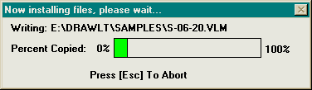
Now, that’s progress!
ESE — User Interface Design
© Oscar Nierstrasz
ESE 8.<number>
Notes:
Now, that’s progress!
This example was taken from the installation of Drawing Board LT , a shareware CAD program. During the course of the installation, several hundred files are copied to your hard drive. Rather than indicate the progress of the entire installation, the authors decided that it was more important to indicate the installation progress of each file. The end result of this design descision is that the user has absolutely no idea as to the state of the installation. Most of the files are small (less than 10KB), causing the filename to be overwritten with such rapidity that it is impossible to read the name of the file. That's not too much of a problem, since ... well, "Who cares about the names of the files as they are installed?! "The more shameful aspect of the installation is that the fluorescent green progress meter becomes a completely useless distraction. It flickers with such rapidity that you are forced to turn your eyes away, or better yet, leave the room before installing the software.

Slide 38

I want them all!
ESE — User Interface Design
© Oscar Nierstrasz
ESE 8.<number>
Notes:
I want them all!
In the Font dialog box for Word 97 the user can set text attributes using an array of checkboxes; no problem there. However, there a 4 pairs of mutually exclusive options listed: strikethrough/double strikethrough, subscript/superscript, emboss/engrave, and all caps/small caps. the controls look like checkboxes but behave like option buttons. Obviously, using option buttons would have spoiled the aesthetics of the control group.

Slide 39
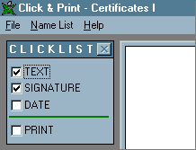
Yes, I want that print thing too
ESE — User Interface Design
© Oscar Nierstrasz
ESE 8.<number>
Notes:
Yes, I want that print thing too
While checkboxes typically provide the means by which to specify options, Click & Print uses checkboxes as indicators and as command buttons. When the user clicks on a checkbox in Click & Print , a dialog box is opened into which he or she enters information to be printed on a certificate. The checkbox only becomes checked if the user clicks the OK button on the related dialog box. Setting the date is particularly unusual. The program defaults to the current date, but the only way to get the date checkbox checked is to click it, then click the OK button in the Date dialog. The most problematic aspect of the design is evident when the user attempts to check the Print checkbox before he or she has checked all of the checkboxes above it: An error message is displayed, stating "The checklist is not complete. Are you sure you want to print?" Here's a lesson from GUI 101: Checkboxes are used to toggle an option on or off Command buttons are used to initiate actions. Don't let your confusion confuse the user.

Slide 40
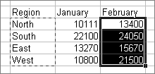
In Excel, “cut” doesn’t mean cut
ESE — User Interface Design
© Oscar Nierstrasz
ESE 8.<number>
Notes:
In Excel, “cut” doesn’t mean cut
Select Cut from the Edit menu of just about any application and what happens? The selected text or object is removed (and a copy is placed in the clipboard for later use). This rule is so ingrained that the phrase "Cut and Paste" could be considered a cultural archetype: almost everyone over the age of four knows what it means. Unfortunately, the designers of Microsoft's Excel weren't familiar with the phrase. To them, "Cut" means "Leave it there", or at least, "Leave it there until I Paste it somewhere else." Upon selecting Cut, a moving border is drawn around the selection, which indicates, intuitively speaking, Nothing! Cut will not remove the selection until the user selects Paste at some later time. In Excel, "Cut" really means "Indicate the selection you might want to Move at some later time". In fact, after performing the Paste operation of the complete Cut and Paste sequence, the Undo command is labeled "Undo Move". By changing the rules, every new or occasional user of Excel is instantly perplexed when performing the Cut operation. The typical user will Cut, and Cut again, and perhaps Cut again in an attempt to understand what he or she has done wrong. They've just got to be chuckling about this one in Redmond. (Thanks to Steve Bliss for reminding us of this Excel feature)

Slide 41
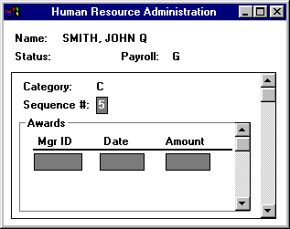
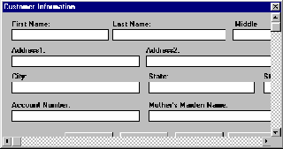
Fun with scrolling!
ESE — User Interface Design
© Oscar Nierstrasz
ESE 8.<number>
Notes:
Fun with scrolling!
Occasionally you'll come across an application that shows such complete disregard for established design principles and industry standards that you have to wonder if the developers have ever used a graphical user interface. This image illustrates a central design idiom used in PeopleSoft applications. A proper critique of PeopleSoft applications would require megabytes of storage, so for the time being we will simply focus on their novel use of scrollbars. Scrollbars in PeopleSoft applications are used as database navigation controls. In the illustration, clicking on the outer scrollbar would display the next category of awards, and clicking on the inner scroll bar would display the next award in the current category. Keep in mind, the frames do not scroll up and down; the information in each is simply replaced. PeopleSoft often nests scrollbars 3 or 4 deep, such that the user becomes absolutely dumbfounded not only as to how the information is arranged, but also as to how to navigate within a window.
Scrollable forms are a sure sign of inexperience in graphical user interface design. These often result from the conversion of legacy applications to the Windows platform, or in the development of applications based on paper forms. Scrolling forms hide important information from the user, hide navigational aids and controls, and require more user inputs to get to the desired information. Unfortunately, visit any programming support forum, and you'll see an ever-increasing number of new programmers asking how to create scrollable forms. The only appropriate answer is, "You don't."

Slide 42
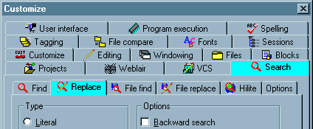
More tabs please!
ESE — User Interface Design
© Oscar Nierstrasz
ESE 8.<number>
Notes:
More tabs please!
To date, we consider this the definitive example of how not to design a tabbed dialog. The sheer number of tabs, combined with the use of iconic labels and the gratuitous use of graphics on the tabs themselves results in a veritable visual assault. Once your eyes recover from the initial assault, you may be able to spot another problem: the use of nested tabs (note that two separate tabs on the dialog are highlighted). MultiEdit's creator, Todd Johnson, wrote to us to state that the design of the options dialog was dictated by the complexity of the program: We have a complex product with a LOT of configurablity, so we end up with a complex configuration dialog, there really isn't anyway around that.

Slide 43
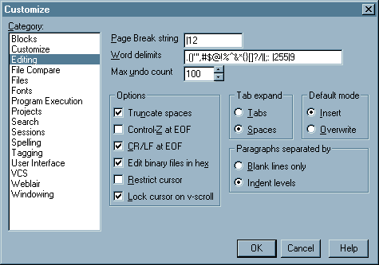
Without tabs
ESE — User Interface Design
© Oscar Nierstrasz
ESE 8.<number>
Notes:
Without tabs
Actually there is. We've put together the following animation to illustrate one alternative design: The alternative offers a number of important advantages over the existing design: Option categories are presented in a consistent order The selection of one category does not alter the order of the others User has keyboard access to switch categories The use of distracting colors has been eliminated The use of distrating images on the tab headings and on the tabs themselves have been eliminated The use of embedded tabs has been eliminated While it is our belief that the proliferation of configuration options in MultiEdit has far exceeded the point of diminishing returns, the alternative design offers one important additional benefit: Additional categories can be added without impacting the design of the form or the user's ability to locate a category The result is a cleaner, more parsimonious dialog in which the user can much more rapidly locate and navigate to the information of interest.

Slide 44
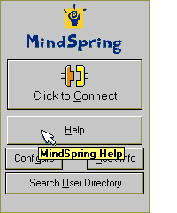
Helpful tips
ESE — User Interface Design
© Oscar Nierstrasz
ESE 8.<number>
Notes:
Helpful tips
Tooltips were intended to provide descriptive information to help new users learn the functions of graphical toolbar buttons. When they are used for standard command buttons, they invariably elicit the following response from users: Duh! As shown in this image from Mindspring's Pipeline+ internet access application, rather than providing useful information to the user, the tooltips merely convey that the designer is, well...let's just say, intellectually challenged .Here's a rule that developers should keep in mind: People generally don't like to use stupid applications

Slide 45
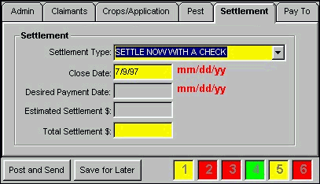
Stop, please
ESE — User Interface Design
© Oscar Nierstrasz
ESE 8.<number>
Notes:
Stop, please
One of our visitors send us a collection of images illustrating the use of a Stoplight Metaphor as it was being used in an application at his company. He wanted to know if we considered it material for the Interface Hall of Fame or the Interface Hall of Shame. Well, here we are. The "stoplights" are displayed in the lower right corner of the window. Their purpose is to indicate the user's progress while entering information in a complicated tabbed dialog box. Stoplight 1 relates to the first tab, Stoplight 2 relates to the second tab, and so on (anyone see a problem here?). The stoplight can be any of three colors: Yellow Some information has been entered on the tab Red Not all required information has been entered Green All required information has been entered While we found a number of problems with the general design of the form, there are some significant problems specifically related to the stoplight metaphor. Too much information . The stoplight metaphor requires the user to learn the meanings of three states, when only one is necessary. The only important indication to the user is that required information on a particular tab is missing. Thus, the interface is unnecessarily cluttered with three distracting colors, when only one is necessary. Conflicting messages . Notice in the image above that the "Post and Send" button is currently enabled, even though the stoplights indicate that required information has not been entered. Our guess is that the stoplight metaphor was developed to provide additional information above that provided by simply disabling the button; specifically, to indicate which tab required completion before the information could be sent. In the current implementation, the user is being simultaneously told that the form can and cannot be submitted. Labeling and Placement of the stoplights . The stoplights are labeled 1 through 6, yet the tabs are not numerically labeled. This will require the user to either physically or mentally determine the tab indicated by the number. Furthermore, the stoplights are located distant from the tabs they represent (the form is much larger than the image shown here), thereby increasing the cognitive burden on the user. We would suggest the following as an alternative, which provides a single "Required Information Needed" indicator, physically proximate to the tab requiring information:

Slide 46
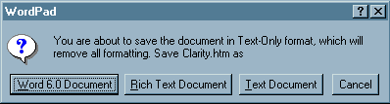
I can’t make up my mind
ESE — User Interface Design
© Oscar Nierstrasz
ESE 8.<number>
Notes:
I can’t make up my mind
Microsoft's WordPad can be infuriatingly stupid. This message was presented after the user has opened an existing text-only document, made some changes (none of which involved formatting changes), and attempted to save it. The user's first response to the message is one of alarm ('REMOVE ALL FORMATTING'?!), but after seeing it the first several hundred times, the response becomes one of anger: 'If I wanted to save it as a different file type, I would have selected Save As , and specified a different file type!' This occurs each time you save the document even if you haven't closed it between changes.

Slide 47
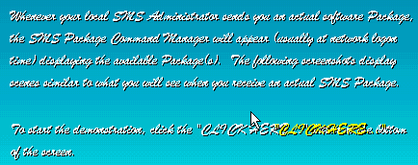
ESE — User Interface Design
© Oscar Nierstrasz
ESE 8.<number>
Notes:
We've come up with a new rule for program developers: You must at least LOOK at your designs before inflicting them onto your users. This image was taken from a tutorial released to members of a very large organization to instruct them in the use of a new software management system. As is clearly evident in the image, the choice of font, color, and background have made the tutorial almost completely unreadable, and therefore, absolutely useless. Try to read the text in the image, and note the intense effort required. The only excuse for such a pitiful combination of screen characteristics is that the developer never looked at his or her creation; as such, there is no excuse.

Slide 48
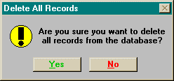
Green good — red bad
ESE — User Interface Design
© Oscar Nierstrasz
ESE 8.<number>
Notes:
Green good — red bad
Sometimes the best intentions of the developer go unrealized. This image was borrowed from one particular application that hard-coded the colors of the text in the command buttons such that all affirmative buttons (OK, Yes, Open) have green-colored text and all negative buttons (Cancel, No, Close) have red-colored text. Unfortunately, doing so can cause a number of problems. In the first place, the background color of the button is determined by the Windows color preferences. As shown above, hard-coding the color of the text can make it difficult, and in some cases, impossible to read. Secondly, as shown in this example, Green/Red-Affirmative/Negative distinction may be inconsistent with a particular task. In western society, users may interpret the green label as indicating the "good" or proper response. As shown in this example however, deleting all records is more than likely not a good thing to do. Additionally, enforcing your particular color associations on your users may create some incompatibilities with cultural interpretations of color. In certain eastern societies, for example, red is considered an affirmative, or positive color. Subjecting these users to your color associations is an indication of cultural arrogance. Finally, a significant percentage of the population has some degree of color vision deficiency; the most prevalent of which, is the diminished ability to distinguish between red and green. Your attempts to provide unnecessary additional information will be lost on a significant portion of your users, and may become a source of their resentment. To be on the safe side, avoid using color as a means of interpretation, and be certain to avail yourself of the user's color preferences. These preferences are not merely the means by which the user "personalizes" his or her PC, but in many instances are selected to maximize the readability of the applications under specific lighting and display conditions. When you avail yourself of these settings, you can be certain that you will not risk the resentment of the user.

Slide 49
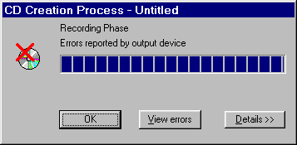

Was that an error?
ESE — User Interface Design
© Oscar Nierstrasz
ESE 8.<number>
Notes:
Was that an error?
Joost Vunderink sent along a couple of images illustrating a fundamental design problem with Easy CD Creator , a program used to write CD-ROMS. At the end of creating a CD, there are two possible outcomes: the process was successful, or 'some error occured' (a not infrequent result when writing CD-ROMS). The error message is displayed above. The successful message is displayed below. So what's is the problem? The dialogs are far too similar, and both utilize a red-heavy icon to represent success or failure. As Joost indicates: Each time I've finished a CD I see something red and I panic... but then it's alright after all.

Slide 50
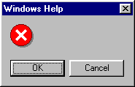
Uh … ok
ESE — User Interface Design
© Oscar Nierstrasz
ESE 8.<number>
Notes:
Uh … ok
We came across this confidence-inspiring message in several areas of Microsoft's Visual Basic 5.0 . The first time it appeared, we took a chance and hit the OK button, which only had the effect of displaying the same message again. Clicking the Cancel button cleared the message and the program proceeded apparently as it should.

Slide 51
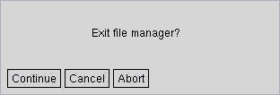
Yes — I mean, no
ESE — User Interface Design
© Oscar Nierstrasz
ESE 8.<number>
Notes:
Yes — I mean, no
At the risk of offending our many Linux visitors, we have included this example of geekspeak sent to us by visitor Paul Winkler . The message is displayed when the user attempts to exit XFM , the "X-windows File Manager". The hapless user is faced with three rather ambiguous options, leading to such questions as: does "Continue" mean "continue using XFM" or "continue to exit"? Is "Cancel" somehow different from "Abort"? Isn't it about time someone complained about this? Actually, "Continue" means "continue to exit"; if you would rather not exit XFM , then you are expected to select either "Cancel" or "Abort". What's the difference? Apparently nothing.

Slide 52

No, I don’t want to trash my disk!
ESE — User Interface Design
© Oscar Nierstrasz
ESE 8.<number>

Slide 53
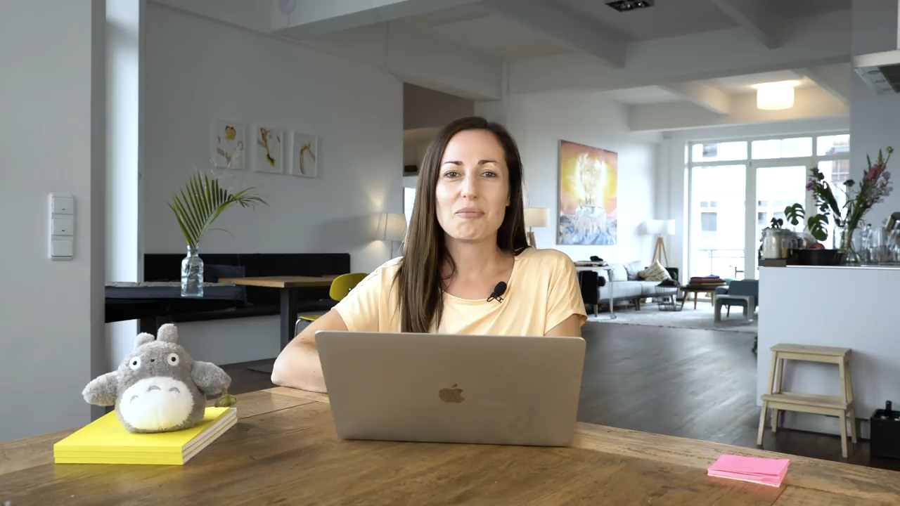
ESE — User Interface Design
© Oscar Nierstrasz
ESE 8.<number>

Slide 54
Key points
ESE — User Interface Design
The user interface design process involves user analysis, system prototyping and prototype evaluation.
User interface design principles should help guide the design of user interfaces.
Interaction styles include direct manipulation, menu systems form fill-in, command languages and natural language.
Graphical displays should be used to present trends and approximate values. Digital displays when precision is required.
Colour should be used sparingly and consistently.
The goals of UI evaluation are to obtain feedback on how to improve the interface design and to assess if the interface meets its usability requirements.
© Oscar Nierstrasz
ESE 8.<number>

Slide 55
What you should know!
ESE — User Interface Design
What models are important to keep in mind in UI design?
What is the principle of minimal surprise?
What problems arise in designing a good direct manipulation interface?
What are the trade-offs between menu systems and command languages?
How can you use colour to improve a UI?
In what way can a help system be context sensitive?
© Oscar Nierstrasz
ESE 8.<number>

Slide 56
Can you answer the following questions?
ESE — User Interface Design
Why is it important to offer “keyboard short-cuts” for equivalent mouse actions?
How would you present the current load on the system? Over time?
What is the worst UI you every used? Which design principles did it violate?
What’s the worst web site you’ve used recently? How would you fix it?
What’s good or bad about the MS-Word help system?
© Oscar Nierstrasz
ESE 8.<number>

Slide 57

License
ESE — User Interface Design
http://creativecommons.org/licenses/by-sa/3.0/
Attribution-ShareAlike 3.0 Unported
You are free:
  to Share — to copy, distribute and transmit the work
  to Remix — to adapt the work
Under the following conditions:
  Attribution. You must attribute the work in the manner specified by the author or licensor (but not in any way that suggests that they endorse you or your use of the work).
  Share Alike. If you alter, transform, or build upon this work, you may distribute the resulting work only under the same, similar or a compatible license.
For any reuse or distribution, you must make clear to others the license terms of this work. The best way to do this is with a link to this web page.
Any of the above conditions can be waived if you get permission from the copyright holder.
Nothing in this license impairs or restricts the author's moral rights.
© Oscar Nierstrasz
ESE 8.<number>

